Slide 1
Agenda for public meeting March 15, 6:30 PM by Zoom:
Welcome and introductions - Kevin Peacey
Agenda and Format - Carrie Saxifrage
Inventory Project - Carrie Saxifrage
Summary of the last year – Mark Lombard
  Carrington operation
  Green Mountain planting
  Stocking standards/FSP – Ione Brown, RPF
Upcoming plans
  Von Donop South – Mark Lombard
  Fire mitigation funding and plans – Mark Lombard
  Permanent sample plots - Mark or Carrie
  Adapting CFGP plans to Klahoose Treaty lands – Georgina Silby
Questions - compiled/facilitation by Carrie

Slide 2
Questions & Answers
As your questions arise during the presentations, press the “Chat” button at bottom of the screen and type in your question. The questions will be answered at the end of the presentation in the order asked.
If you have a question during the question period, press the “Reactions” button at the bottom of the screen and select the raised hand. I’ll make a speakers list
Everyone came into the meeting muted to decrease the background noise. To speak, click “Unmute” in lower left corner. When you are done, press “Mute” (same place)

Slide 3
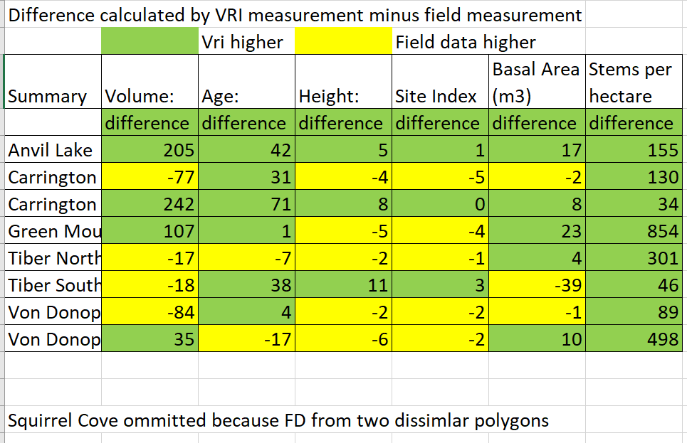
Forest Inventory Project
Field Data (FD) collected by volunteers compared to provincial Vegetative Resources Inventory (VRI)
Purpose: determine reliability of provincial data used to measure volume and mean annual increment
Result:
Volume:
FD higher in 4 plots, VRI higher in 4 plots
2) Age:
FD older in 2 plots, VRI older in 6 plots
3) Height:
FD higher in 5 plots, VRI higher in 3 plots
4) Basal Area:
FD greater in 5 plots, VRI greater in 3 plots
5) Stems per hectare:
VRI greater in all plots
Conclusion
The data is based on small samples in an area with great variability, so it gives a very general picture.
The province’s timber supply analysis is within the ballpark for practical purposes.
There will be a more in-depth presentation/discussion at some point. Let me know in the chat if you are interested.

Slide 4
Summary of the Last Year

Slide 5
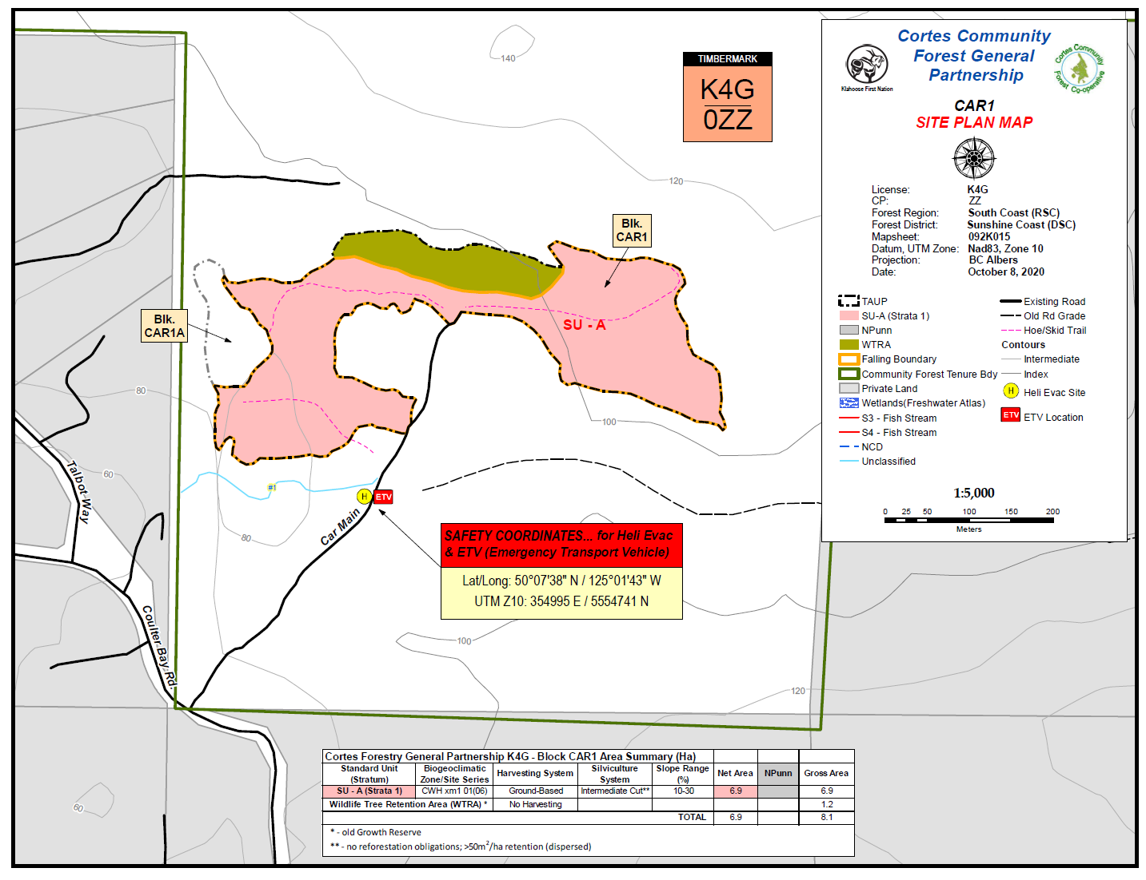
Carrington Site Plan

Slide 6
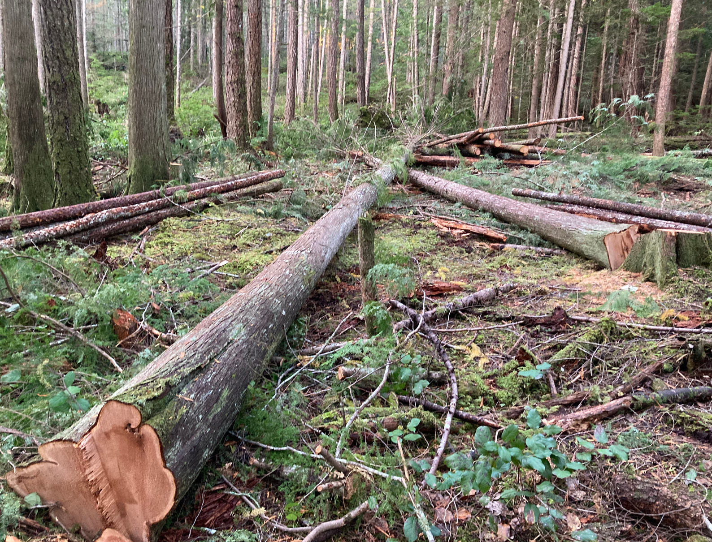
Cedars from the thinning at CAR1 donated to the Cortes Island School Outdoor Learning Center

Slide 7
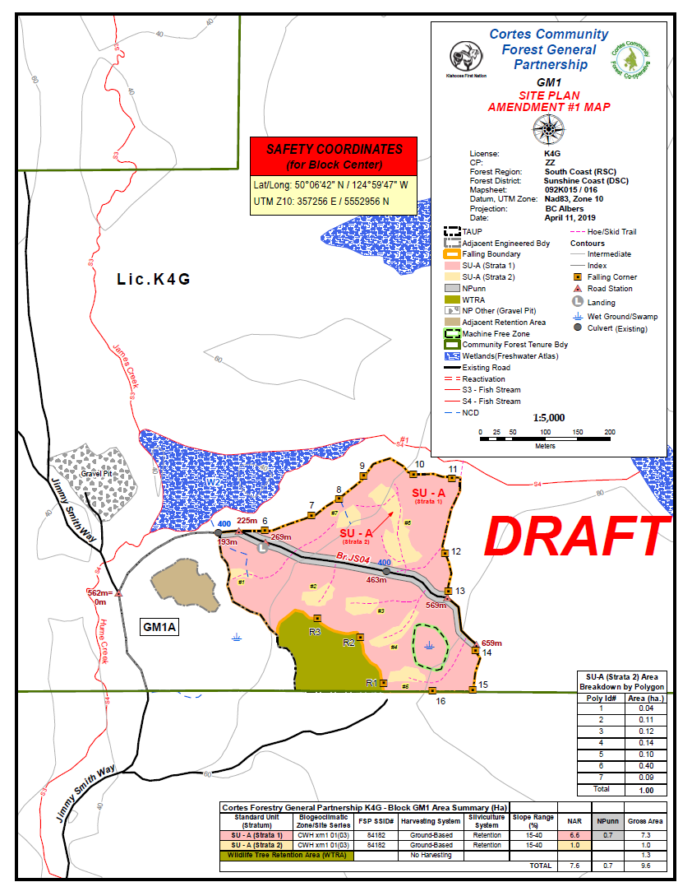
Green Mountain
Site Plan

Slide 8
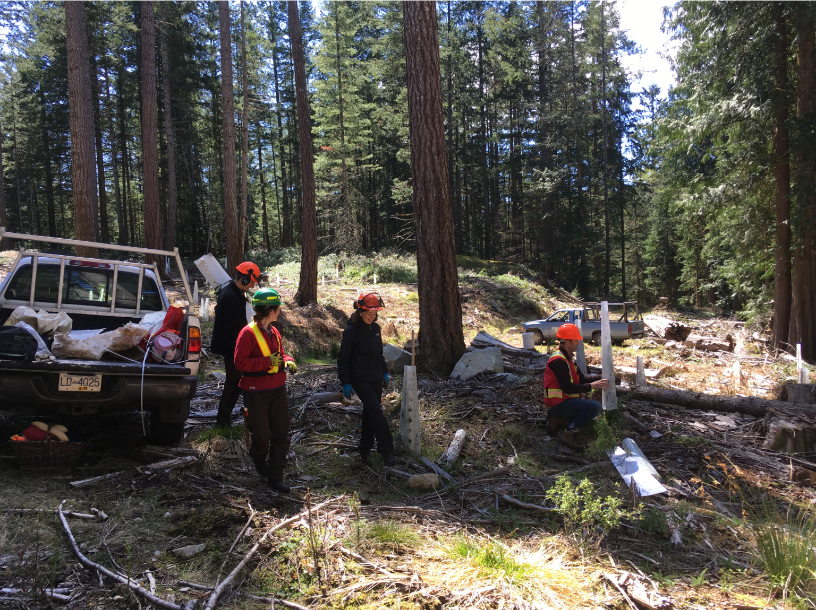
Volunteer
Tree Tending
Larsons Meadow

Slide 9
Forest Stewardship Plan Stocking Standards

Slide 10
Upcoming Plans

Slide 11
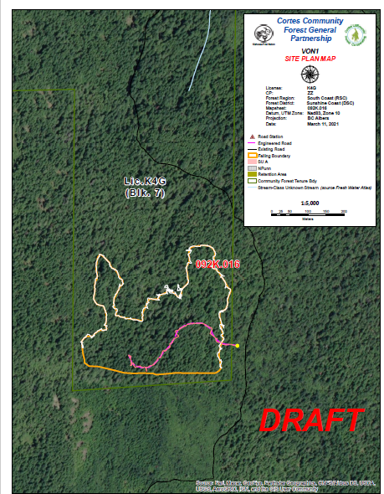
Von Donop
Area Under Consideration
VON 1

Slide 12
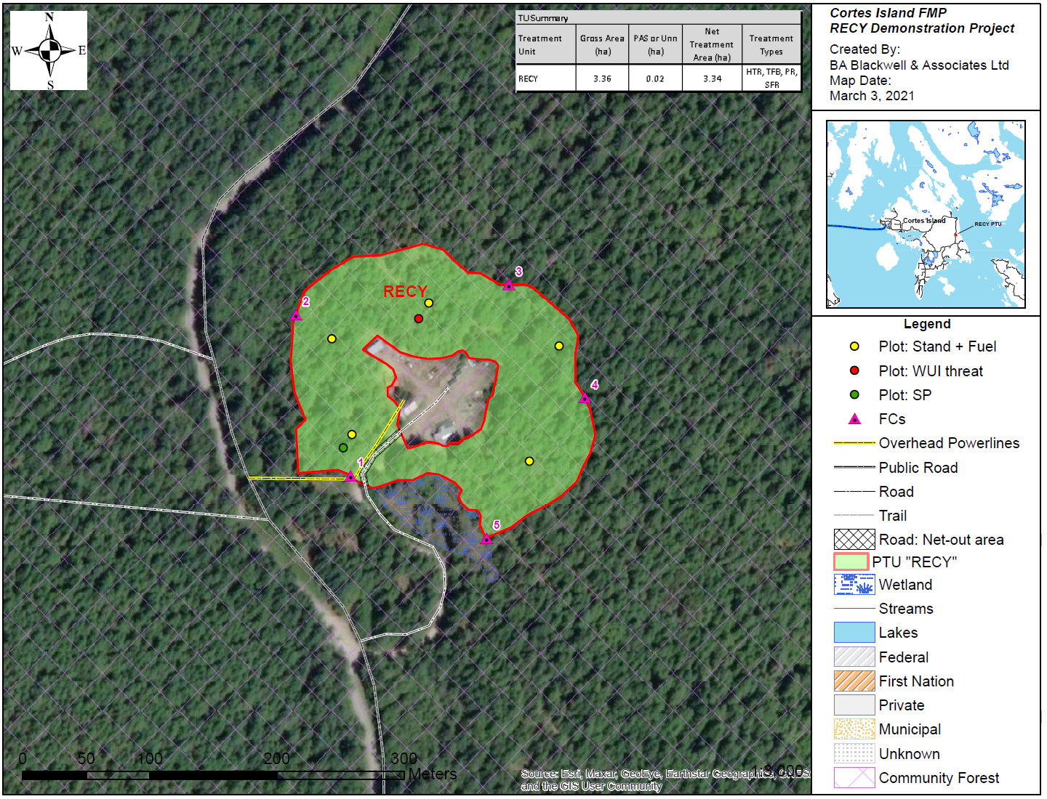
Recycling
Center
Fire
Mitigation
Plan

Slide 13
Thank you for
showing up!

